Slide 1
ECG spectrogram scalogram

Slide 2
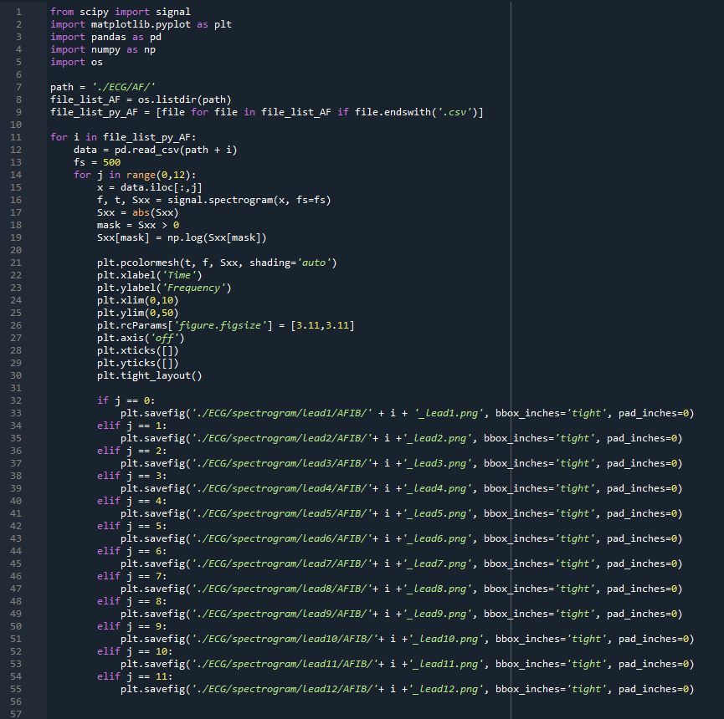
spectrogram code

Slide 3
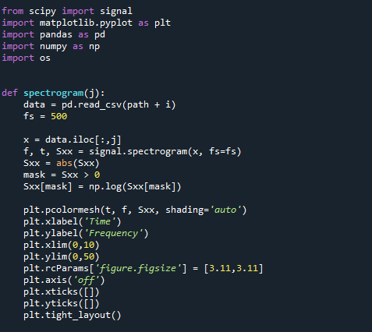
spectrogram code1

Slide 4
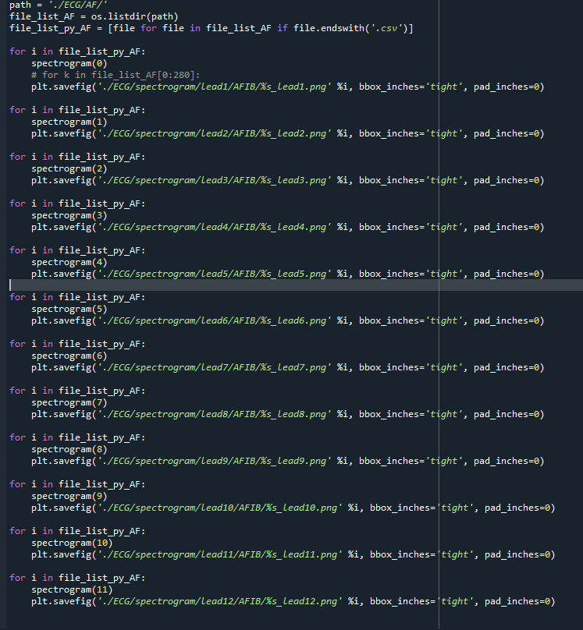

Slide 5
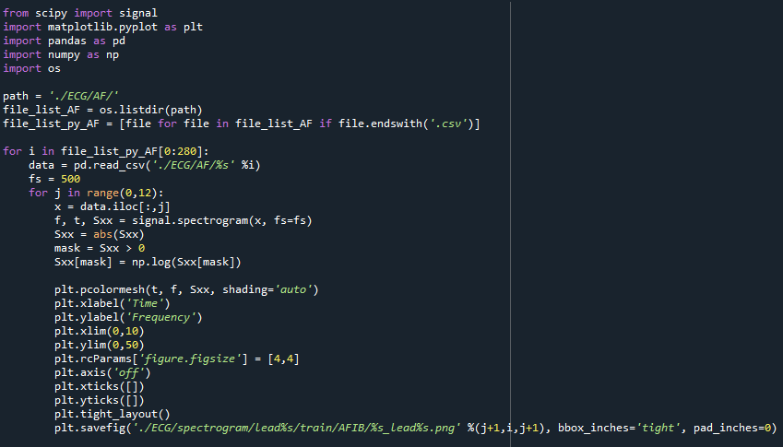
spectrogram code2

Slide 6
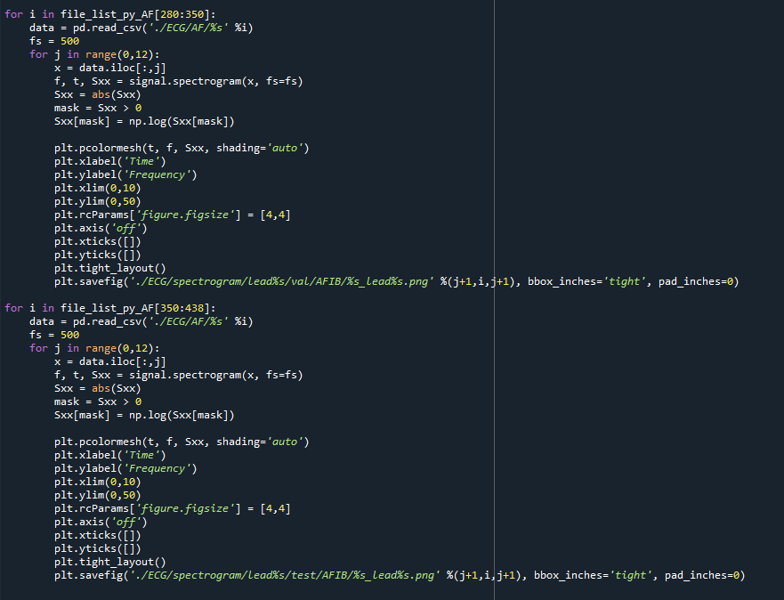

Slide 7
Train, Validation,Test
 | Train | val | test
AF | 280 | 70 | 88
AFIB | 1139 | 285 | 356
AT | 78 | 19 | 24
AVNRT | 10 | 3 | 3
AVRT | 5 | 1 | 2
SA | 254 | 64 | 79
SAAWR | 5 | 1 | 1
SB | 2488 | 622 | 778
SR | 1168 | 292 | 365
ST | 1001 | 250 | 313
SVT | 348 | 87 | 109
Train 64%, val 16%, test 20%

Slide 8
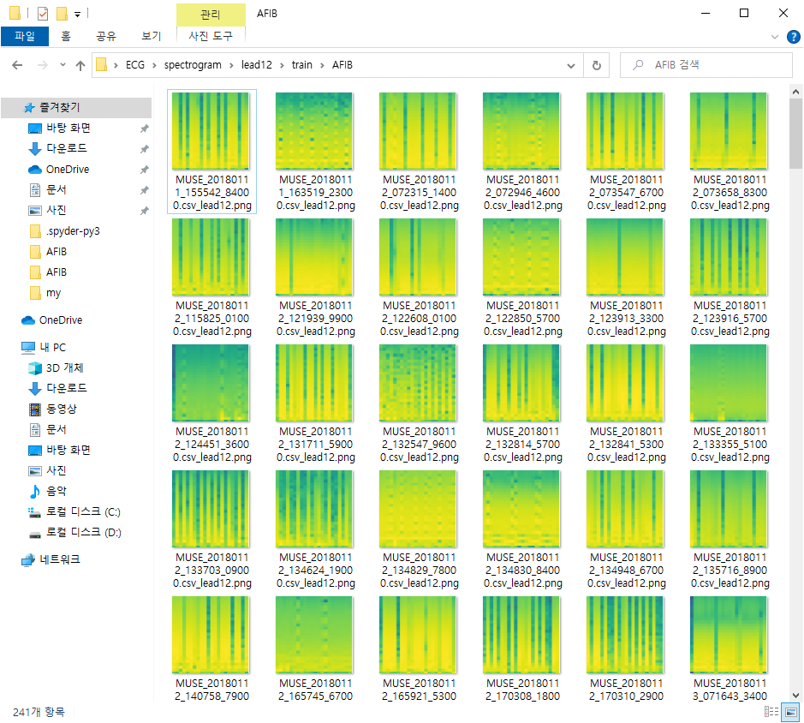
Spectrogram

Slide 9
감사합니다

